Slide 1
Machine Learning Regression Model
Mental Illness in Communities Estimator
September 2020
Francis Morales

Slide 2

Project Objective
Estimate the percentaje of population with mental illnesses in communities to help local governments and health organizations raise awareness and allocate resources in mental care to build better lives for those affected.

Slide 3

Mental Illness in the U.S.
What is a mental illness?
Mental illness is defined as having a diagnosable mental, behavioral, or emotional disorder, other than a developmental or substance use disorder
1 in 5 U.S. adults experience mental illness (19%)
1 in 6 U.S. youth experience mental illness (6-17 years)
90% of people who die by suicide have experienced symptoms of a mental health condition
11 Years
The average delay between symptom onset and treatment
Sources:
https://nami.org/About-Mental-Illness
https://www.samhsa.gov/
https://www.psychiatry.org/

Slide 4

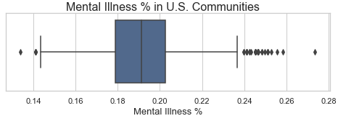



DATASET
METHODOLOGY & MODEL OVERVIEW
820 counties from 48 states (26% counties) – excluding Hawaii and Alaska
30 different features: economic, demographics, family structure, education and weather
3 data sources: API & Data Download
Data Sourcing
& Scrubbing
Exploratory Data Analysis
Model Training & Evaluation
Delivery of Results
Model Selection: Support Vector Regressor Model with a RMSE of 1.54% and R2 of 0.445
Regression Model | RMSE | R2
Baseline | 0.021 | -0.001
SVR | 0.0154 | 0.445
Random Forest Regr. | 0.0167 | 0.348
XGBRegressor | 0.0156 | 0.432
Deep Neural Network | 0.017 | 0.27

Slide 5
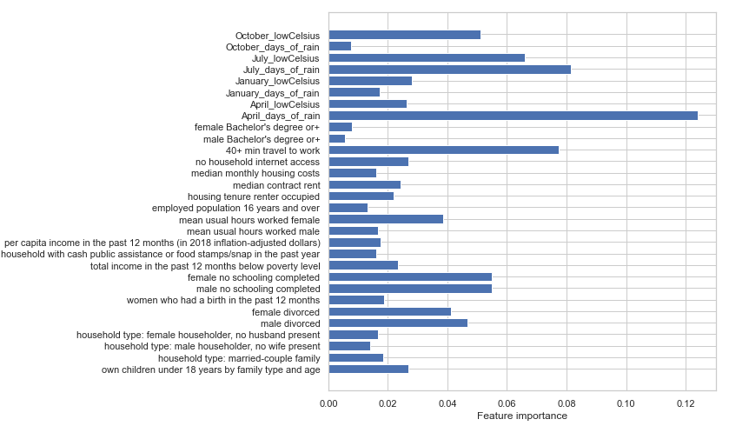
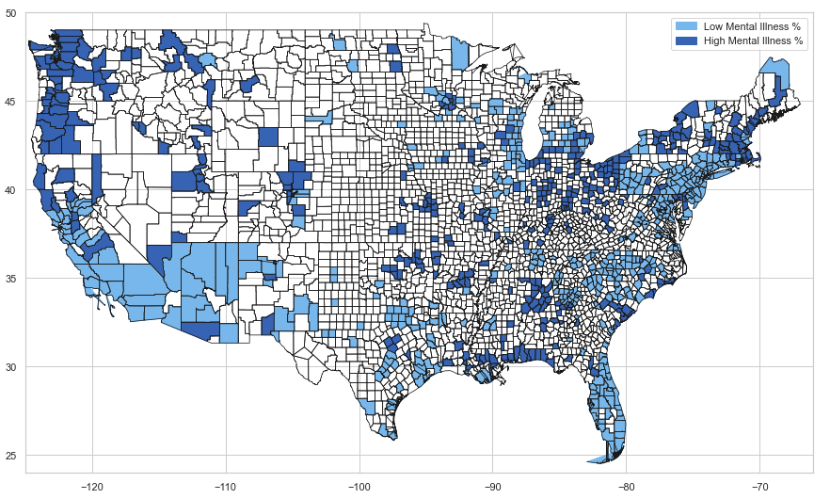



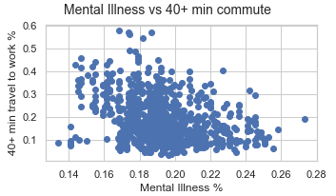
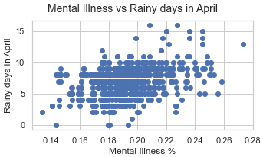
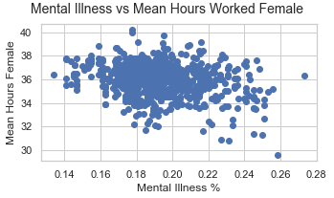
DATA INSIGHTS
MENTAL ILLNESS IN COUNTIES
Counties with higher rates of long commutes show less % of mental illness
Counties with higher number of rainy days in January, April and October show higher % of mental illness
Counties were women work less hours show higher % of mental illness

Slide 6
RECOMMENDATIONS / NEXT STEPS
Tune model parameters to improve RMSE and R2 before moving model to production
Review dataset to eliminate noise from unnecessary variables
Explore further insights from independent variables

Slide 7
Thanks!
Any questions?
You can find me at https://www.linkedin.com/in/francis-morales-89b22b66/

